Slide 1

Battle of Neighborhood
Opening a new Indian Restaurant in Toronto

Slide 2
FINDING LOCATION FOR STARTING A NEW INDIAN RESTAURANT
As of 2020, there are one million Indian Citizens in Canada on permanent or temporary status.
Toronto has the largest Indian population. Almost 51% of the entire Indian Canadian community resides in the Greater Toronto Area
Since the Indian population is increasing in Toronto year by year, opening a new Indian restaurant in Toronto is a good business idea for anyone who wants to run their own business.

Slide 3
DATA ACQUISITION AND CLEANING
The data, including postal codes, Boroughs and Neighborhoods scrapped from the Wikipedia page: https://en.wikipedia.org/wiki/List_of_postal_codes_of_Canada:_M
The latitude and longitude values of different Neighborhoods of Toronto was available from: https://cocl.us/Geospatial_data
The location data was accessed from Foursquare location data.
After Data Cleaning, the final dataframe contains 103 rows and 5 columns.

Slide 4
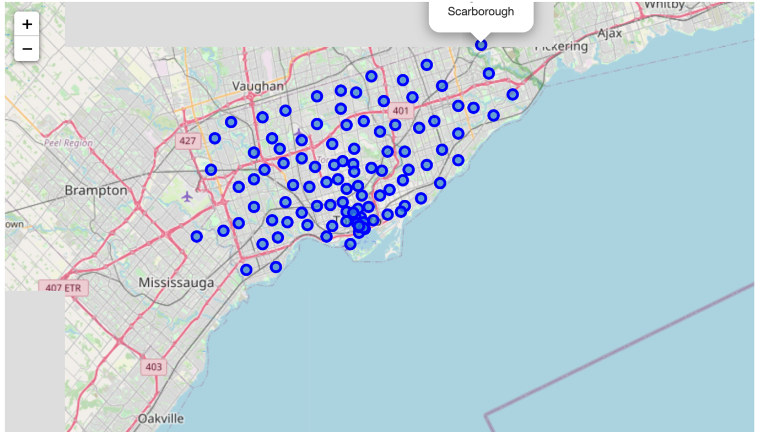
Data exploration
Map of Toronto with Neighborhoods marked as blue circles

Slide 5
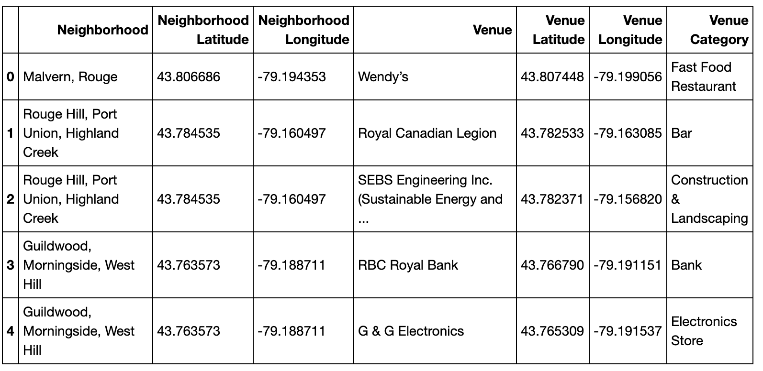
LIST OF VENUES IN TORONTO. THE RESULTING DATAFRAME IS CONSISTS OF 2139 VENUES.

Slide 6
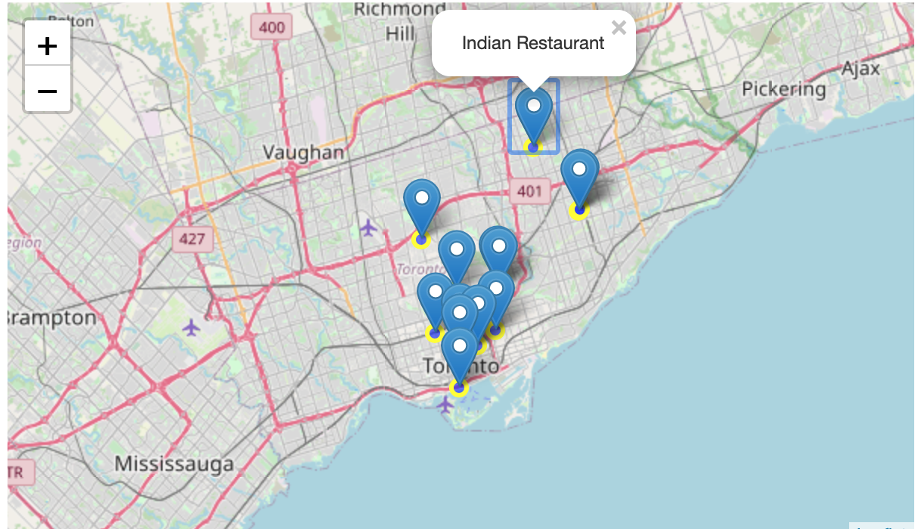
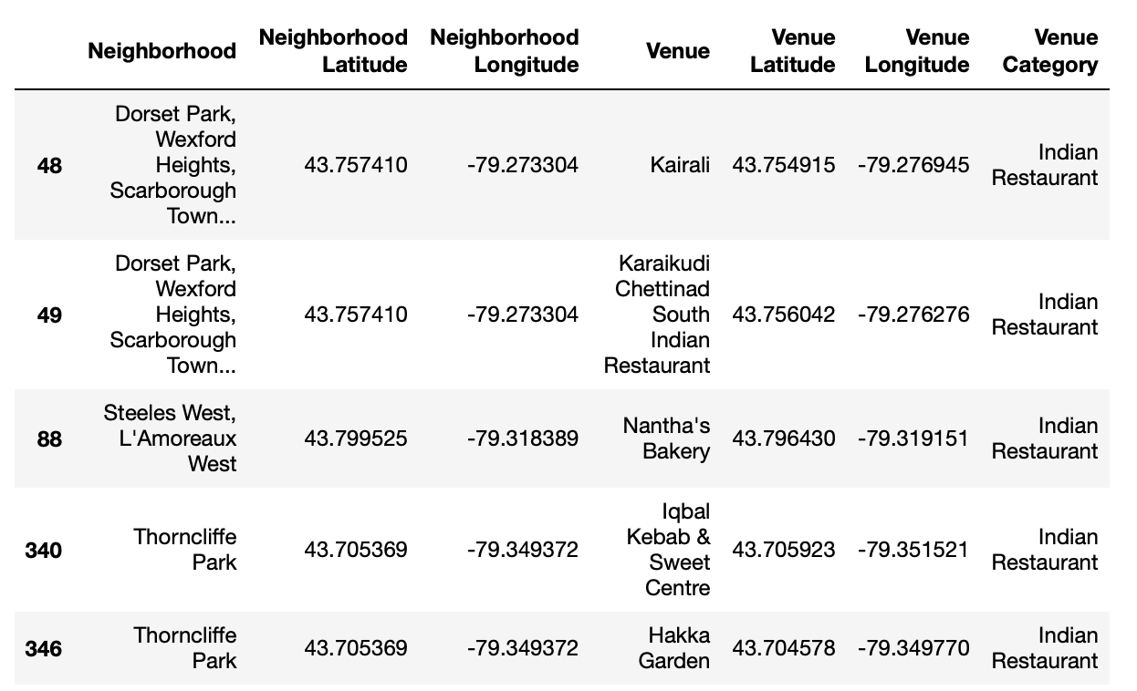
THE INDIAN RESTAURANTS IN TORONTO

Slide 7
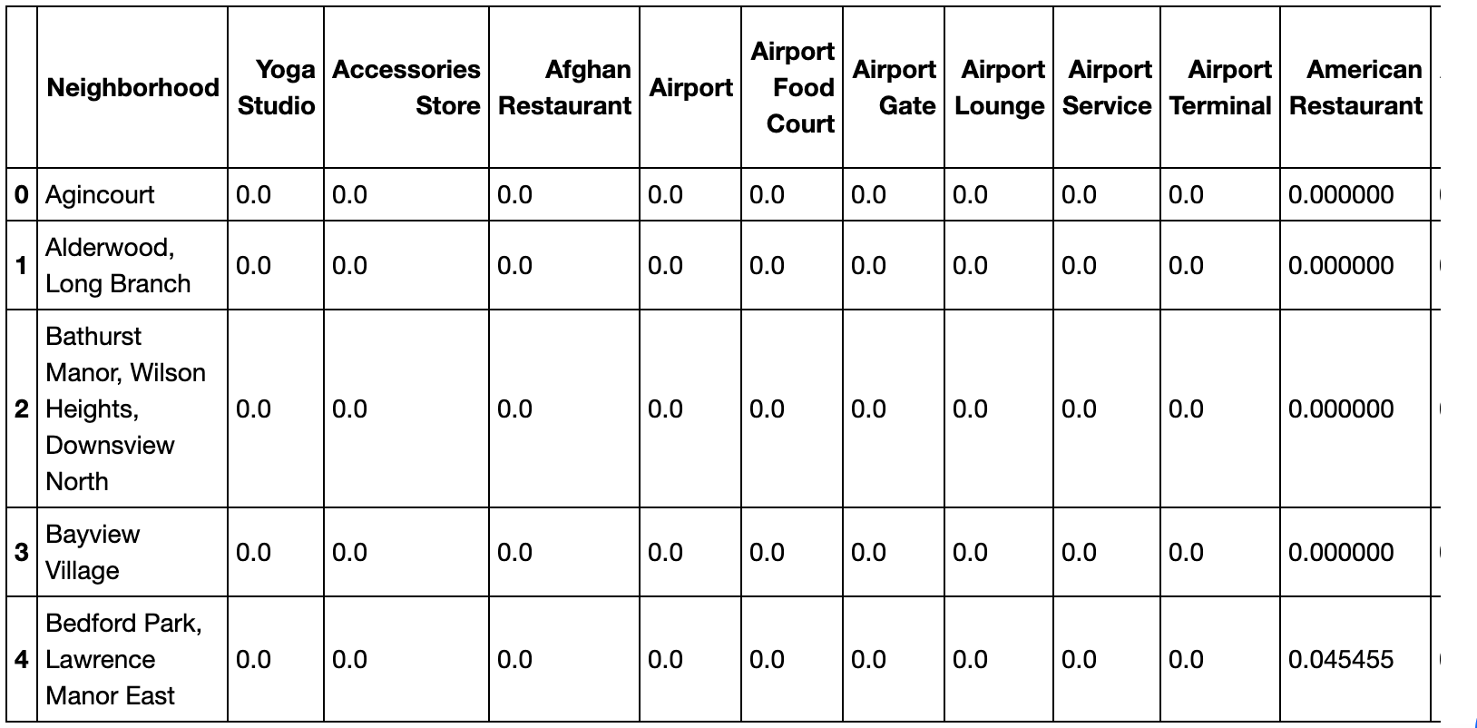
ONE HOT ENCODING

Slide 8
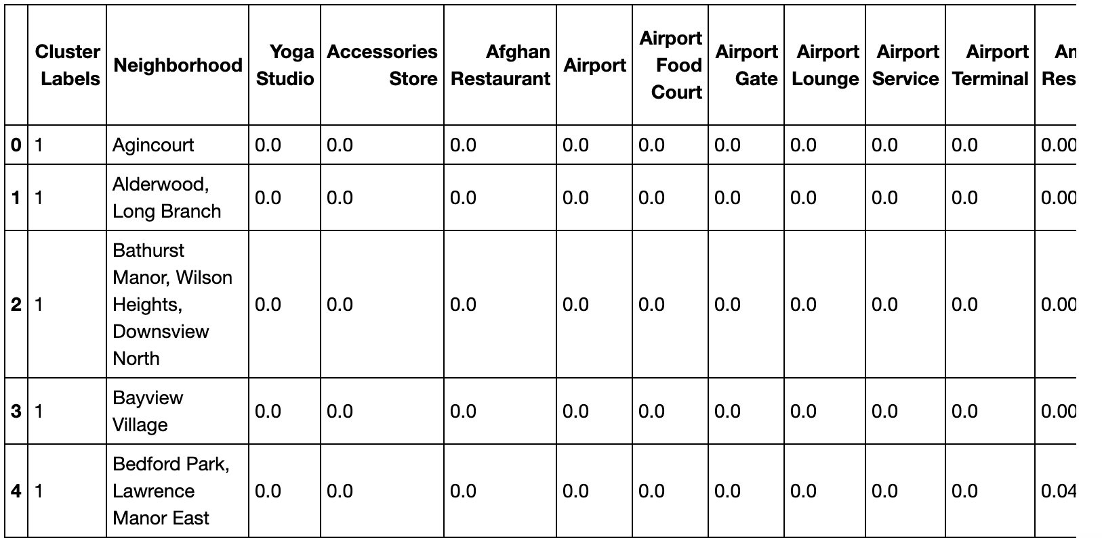
K-means clustering (k=5)

Slide 9
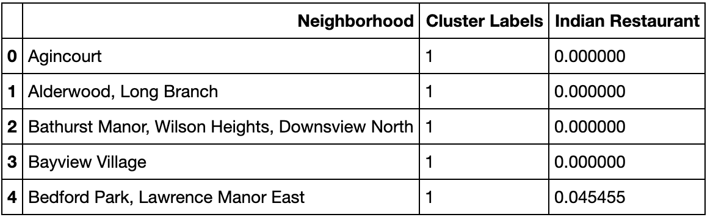
CREATING NEW DATAFRAME BY EXTRACTING INDIAN RESTAURANTS

Slide 10
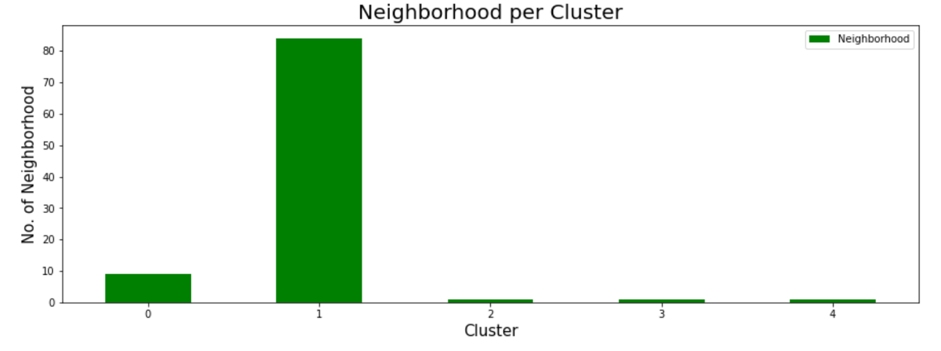
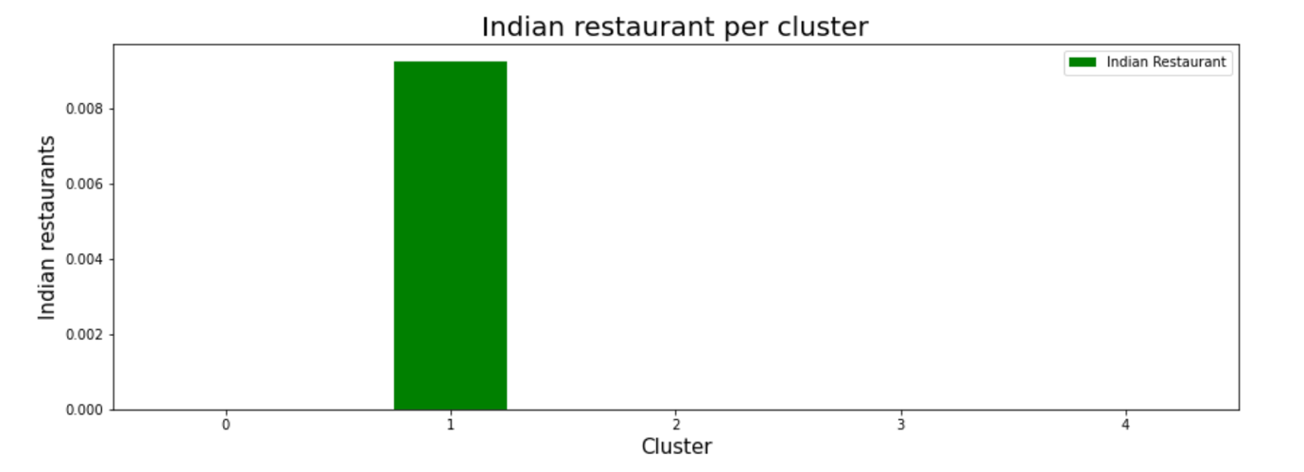
DATA ANALYSIS
Visualizing the Neighborhoods
per Cluster
Visualizing Indian restaurants per cluster

Slide 11
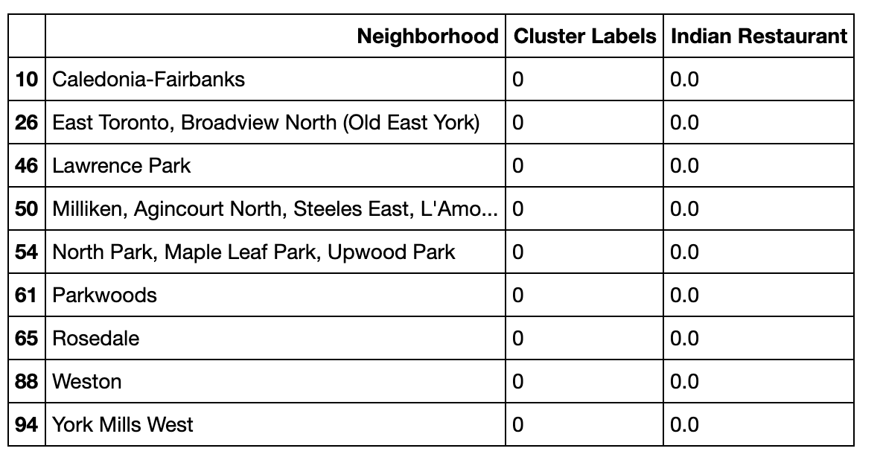
NEIGHBORHOODS IN CLUSTER1

Slide 12
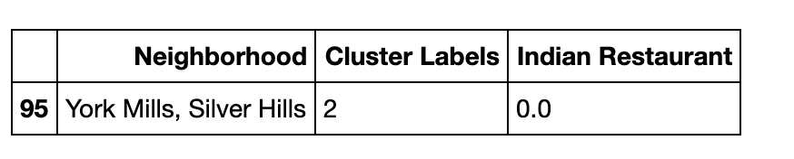
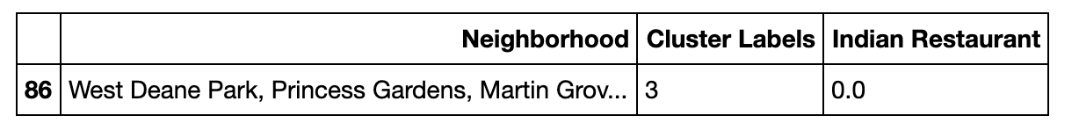
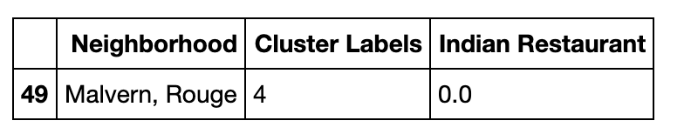
NEIGHBORHOODS IN CLUSTER3
NEIGHBORHOODS IN CLUSTER 4
NEIGHBORHOODS IN CLUSTER 5

Slide 13
CONCLUSION
All the Indian restaurants are in cluster 2.Also, Cluster2 has the maximum number of neighborhoods (more than 90).
Other clusters do not have any Indian restaurants.
Among that cluster 1 has 9 neighborhood and other three clusters have one neighborhood each.
So, we can say that for opening a restaurant with minimum competition, we can choose a location from these four clusters

